Slide 1
Medicaid Results and Hypothesis

Slide 2
Literature/Hypothesis
Job Lock Effect: the tendency for workers to feel they cannot leave a job due to the loss in benefits incurred by leaving.
Employment Lock Effect: workers who are employed primarily to secure private health insurance coverage
Selective Reporting: Individuals in high-knowledge areas change wage earnings sharply to obtain larger EITC refunds relative to those in low-knowledge areas. Does the expansion of Medicaid result in behavioral shifts among self-employment earnings reporting

Slide 3
Hypothesis
H1: Job lock effect, more individuals can engage in self-employment with less reliance on employer supplied health insurance
H2: Employment lock effect, fewer people will engage in self-employment as they no longer require the work to afford health care costs
H3: Selective reporting, The expansion in Medicaid may lead a new group of people to evade reporting on self-employment income to qualify for Medicaid’s cut-off

Slide 4
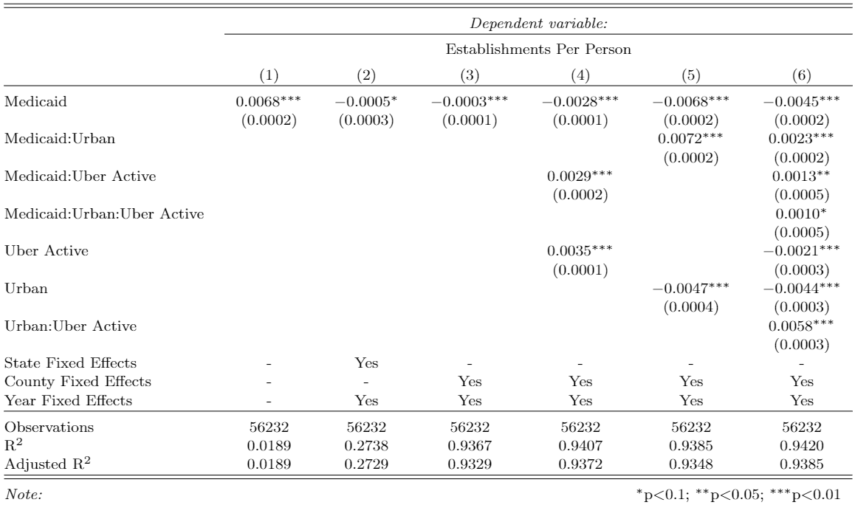

Slide 5
Results
Dependent Variable: Establishments Per Person
Model | Level | Coef. | SE
Two-way Fixed Effect | County | -0.00025*** | 0.00009
Interacted Fixed Effect | County | -0.0029*** | 0.0002
Synthetic Control | County | -0.0045*** | 0.0011
Two-way Fixed Effect | State | -0.0051*** | 0.0011
Interacted Fixed | State | -0.00097 | 0.00096
Synthetic Control | State | -0.0016*** | 0.00046

Slide 6
Synthetic Control:

Slide 7
Synthetic Control:

Slide 8
Synthetic Control:

Slide 9
Synthetic Control:

Slide 10
Synthetic Control Pseudo Medicaid (2009):
Notes:
Re-define Medicaid expansion as happening in 2009 for all states that have it happen in 2014, 2015, 2016, and 2017. Repeat the Synthetic control design for years 2000-2013.

Slide 11
Synthetic Control Pseudo Medicaid (2009):
Notes:
Re-define Medicaid expansion as happening in 2009 for all states that have it happen in 2014, 2015, 2016, and 2017. Repeat the Synthetic control design for years 2000-2013.

